Slide 1

Cybersecurity Infographics
Here is where this template begins

Slide 2
Contesto generale
L’industria della sicurezza usa sempre di più modelli ML per rilevare malware.
In particolare si utilizzano feature statiche estratte da binari Windows PE.
Questi modelli fungono da prima linea di difesa (pre-execution detection) ma sono vulnerabili ad attacchi avversari sempre più sofisticati.

Slide 3
Attacchi avversari
EVASION
POISONING
Manipolazione in inference
Manipolazione in training

Slide 4
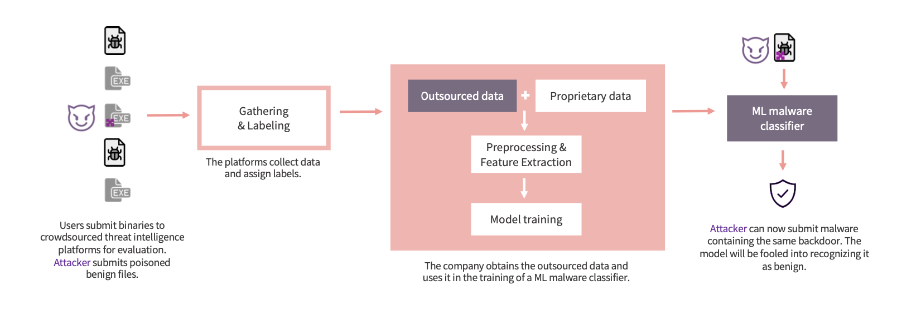
Perché il poisoning è un problema reale?

Slide 5


Focus: Backdoor poisoning
L’attaccante inserisce un trigger, un pattern nelle feature.
Il modello impara ad associarlo alla classe scelta dall’attaccante.
In test, basta reinserire quel trigger che provoca la misclassificazione.

Slide 6
Clean-label backdoor
Tipo di attacco più subdolo.
L’attaccante non modifica l’etichetta cosicché il campione resta “benigno”.
Il trigger viene iniettato solo nelle feature.
Il modello impara associazioni avversarie ma coerenti con i dati (quasi impossibile da rilevare).

Slide 7


Perché è così difficile da difendere?
Mimetizzazione | Il trigger si mimetizza tra le feature reali.
Confusione | I campioni avvelenati finiscono in zone ad alta densità e confondono clustering/analisi.
Assenza di anomalie | Non c’è manipolazione di label

Slide 8

Idea chiave del progetto
Il progetto vuole verificare se campioni backdoorati:
mostrano resilienza alla misclassificazione quando il modello viene perturbato
reagiscono diversamente rispetto ai campioni normali quando si applica rumore o pruning.

Slide 9
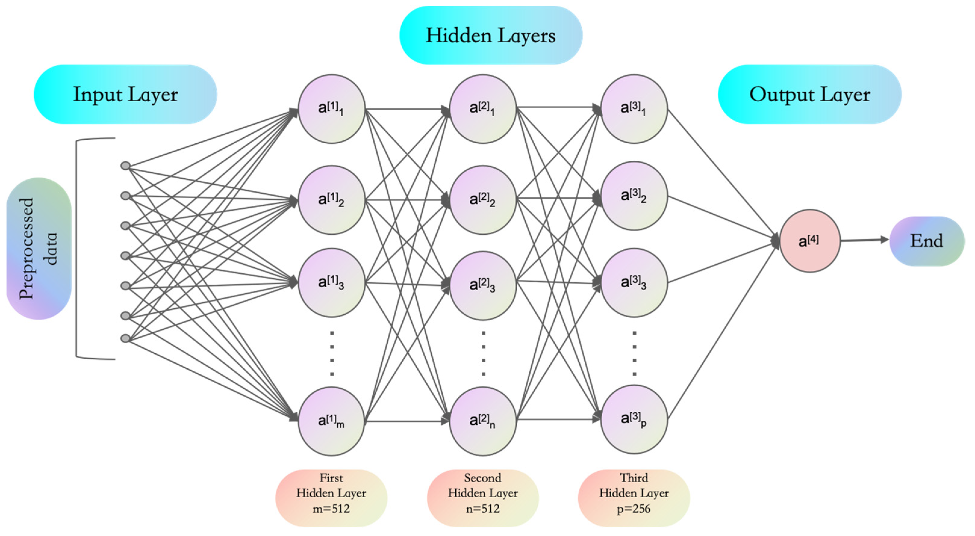
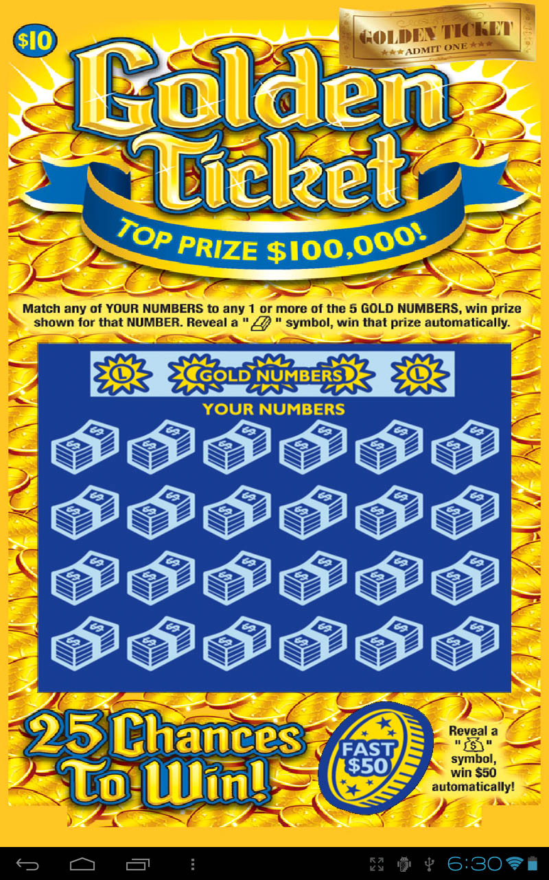
THE LOTTERY TICKET HYPOTHESIS: FINDING SPARSE, TRAINABLE NEURAL NETWORKS
Le reti neurali contengono sottoreti “ottimali” (winning tickets).
Queste sottoreti sono robuste al rumore e alle perturbazioni.
Ipotesi: anche la backdoor potrebbe formare un “percorso furtivo” simile a un winning ticket.

Slide 10

Obiettivo introduttivo
 | Capire se rumore e sparsità possono: far cambiare classificazione ai campioni puliti ma non ai campioni avvelenati ed isolarli.

Slide 11




Tipologie di attacco
Clean-label
Non cambiano le label
Flip-Label
Feature-based
Cambiano le label
Si manipolano solo feature importanti, scelte con SHAP
FEATURES

Slide 12
Clean-label: il più pericoloso
Un attacco clean-label è una forma di backdoor poisoning in cui i campioni avvelenati mantengono la loro etichetta corretta (es. “benigno”). Questo è fondamentale perché:
Nessuno può sospettare manipolazioni dalle etichette.
Le pipeline di data collection non hanno motivi per scartare questi campioni.
I modelli imparano pattern malevoli camuffati da dati legittimi.

Slide 13
Attacchi feature-based
Gli attacchi feature-based non manipolano tutto il vettore di feature, ma agiscono solo su quelle più influenti. Per scoprirle usano strumenti come SHAP, che misurano quanto ogni feature contribuisce alla decisione del modello
Le modifiche colpiscono precisamente le feature significative, non casuali.
Il trigger diventa estremamente potente nel controllare la predizione.
L’alterazione minima, visivamente e statisticamente indistinguibile dai dati reali.

Slide 14
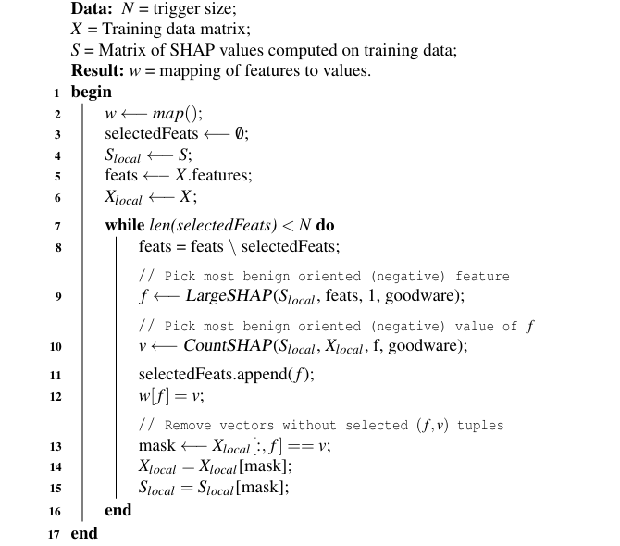
Combined Greedy Selection
È una strategia avanzata per posizionare il trigger nelle feature migliori e nei punti migliori dello spazio dei dati.
L’algoritmo cerca le regioni più dense dei campioni benigni reali.
In quelle regioni inserisce i campioni avvelenati, con le feature manipolate.
Il trigger viene quindi “nascosto” dentro gruppi compatti di benigni.

Slide 15
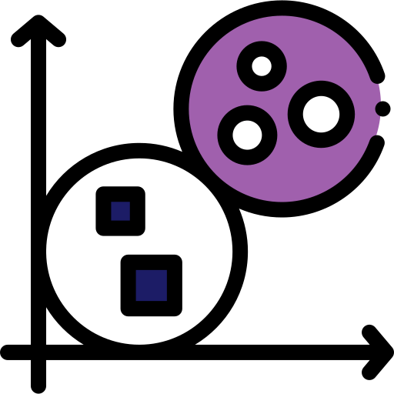
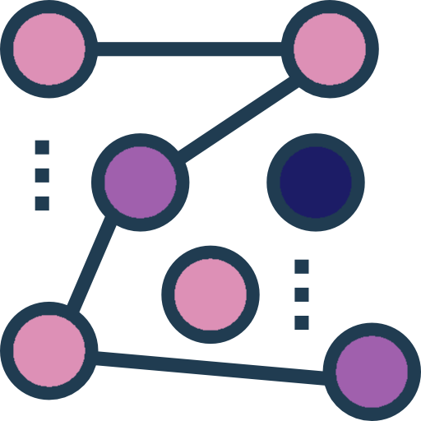

Types of defenses
HDBSCAN
Clustering gerarchico a densità: forma cluster densi e marca come outlier i punti poco densi.
Spectral signatures
Isolation Forest
Isola anomalie costruendo alberi casuali che separano rapidamente punti rari dai normali.
Cerca sottopopolazioni separabili in SVD.
Funziona solo se il trigger crea un cluster isolato

Slide 16
Perché queste difese falliscono?
Clean-label attacca direttamente la struttura dello spazio.
Nessuna delle difese riesce a creare separazione tra classi pulite e avvelenate.

Slide 17
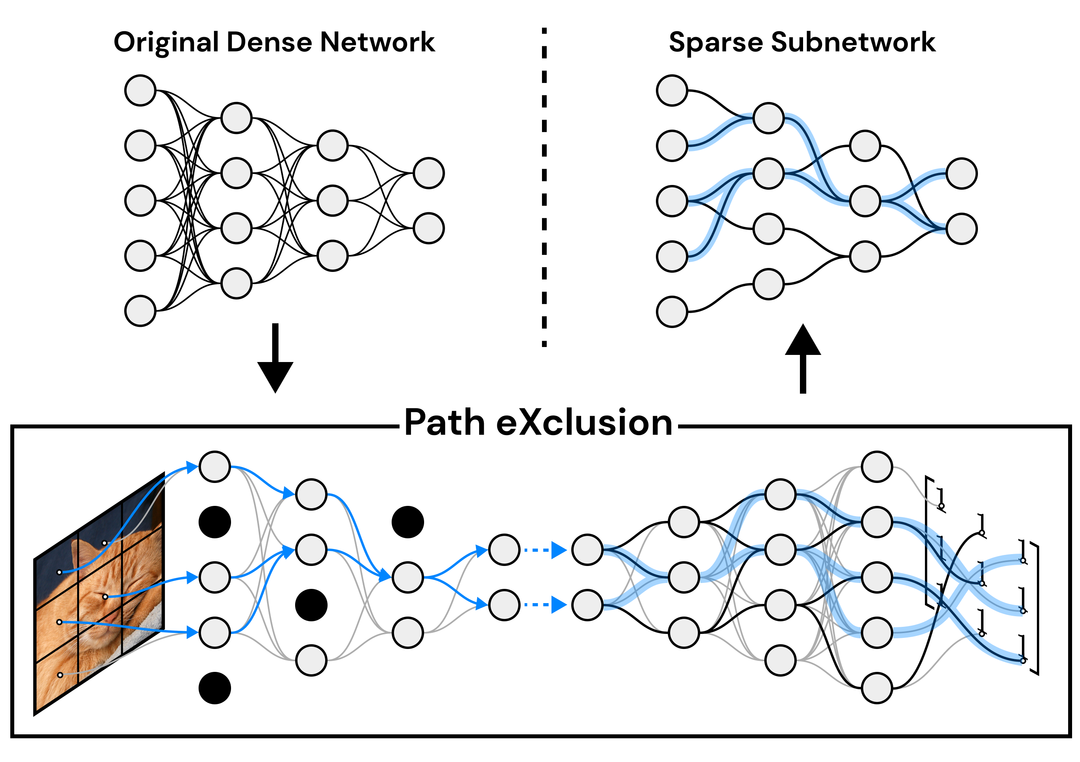
Sparsità come possibile difesa
Eliminare pesi non importanti. I trigger potrebbero essere meno efficaci
Tuttavia, come suggerisce LTH, la backdoor potrebbe essere così ben rafforzata durante il training da comportarsi come una sottorete ottimale, quindi resiste anche se togli pesi.

Slide 18
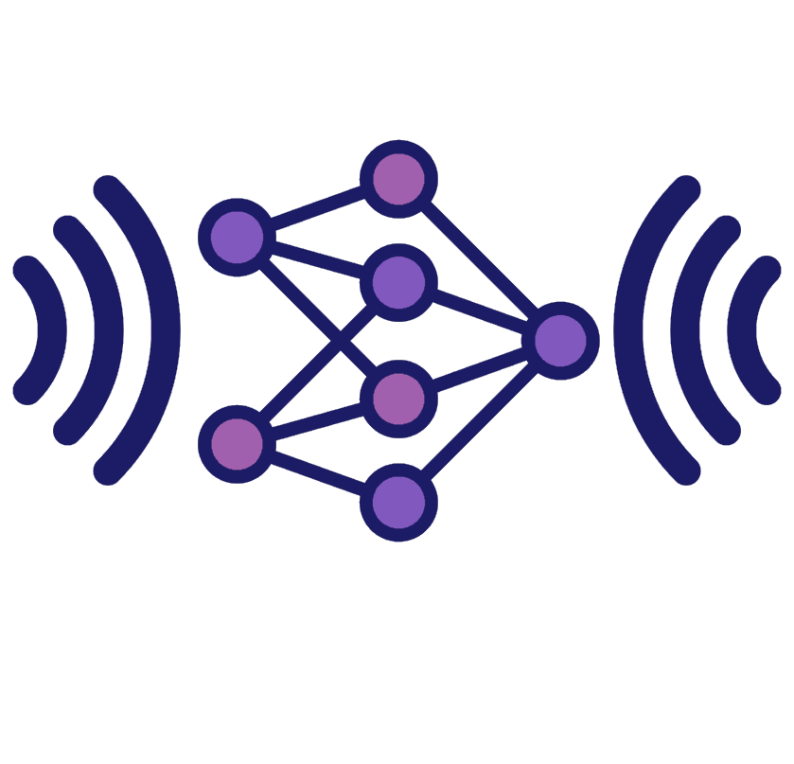
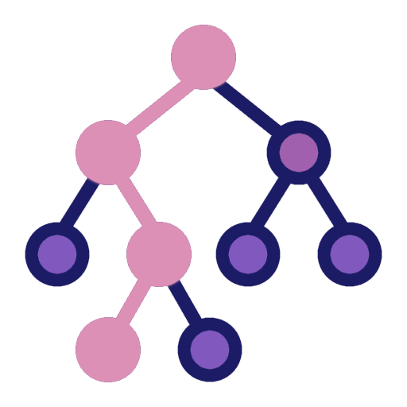
Rumore come possibile difesa
Iniettare rumore controllato nei pesi
Se i trigger creano percorsi “rigidi”, potrebbero non cambiare predizione
Questo contrasto permette potenzialmente la detection

Slide 19

Dataset e Preprocessing
1.1 milioni di campioni PE.
2381 feature numeriche.
Ampiamente usato come benchmark.
Sottoinsieme selezionato per motivi computazionali.

Slide 20

Dataset Ember e Preprocessing
DIMENSIONE
ESTRAZIONE
1.1 milioni di campioni PE.
Feature estratte con l’omonima libreria
FEATURES
NORMALIZZAZIONE
2381 feature numeriche
Normalizzazione completa
ember
RIDUZIONE
FILTRAGGIO
Sottoinsieme selezionato per motivi computazionali.
Rimozione feature: • alta correlazione, • varianza zero, • ridondanza.

Slide 21
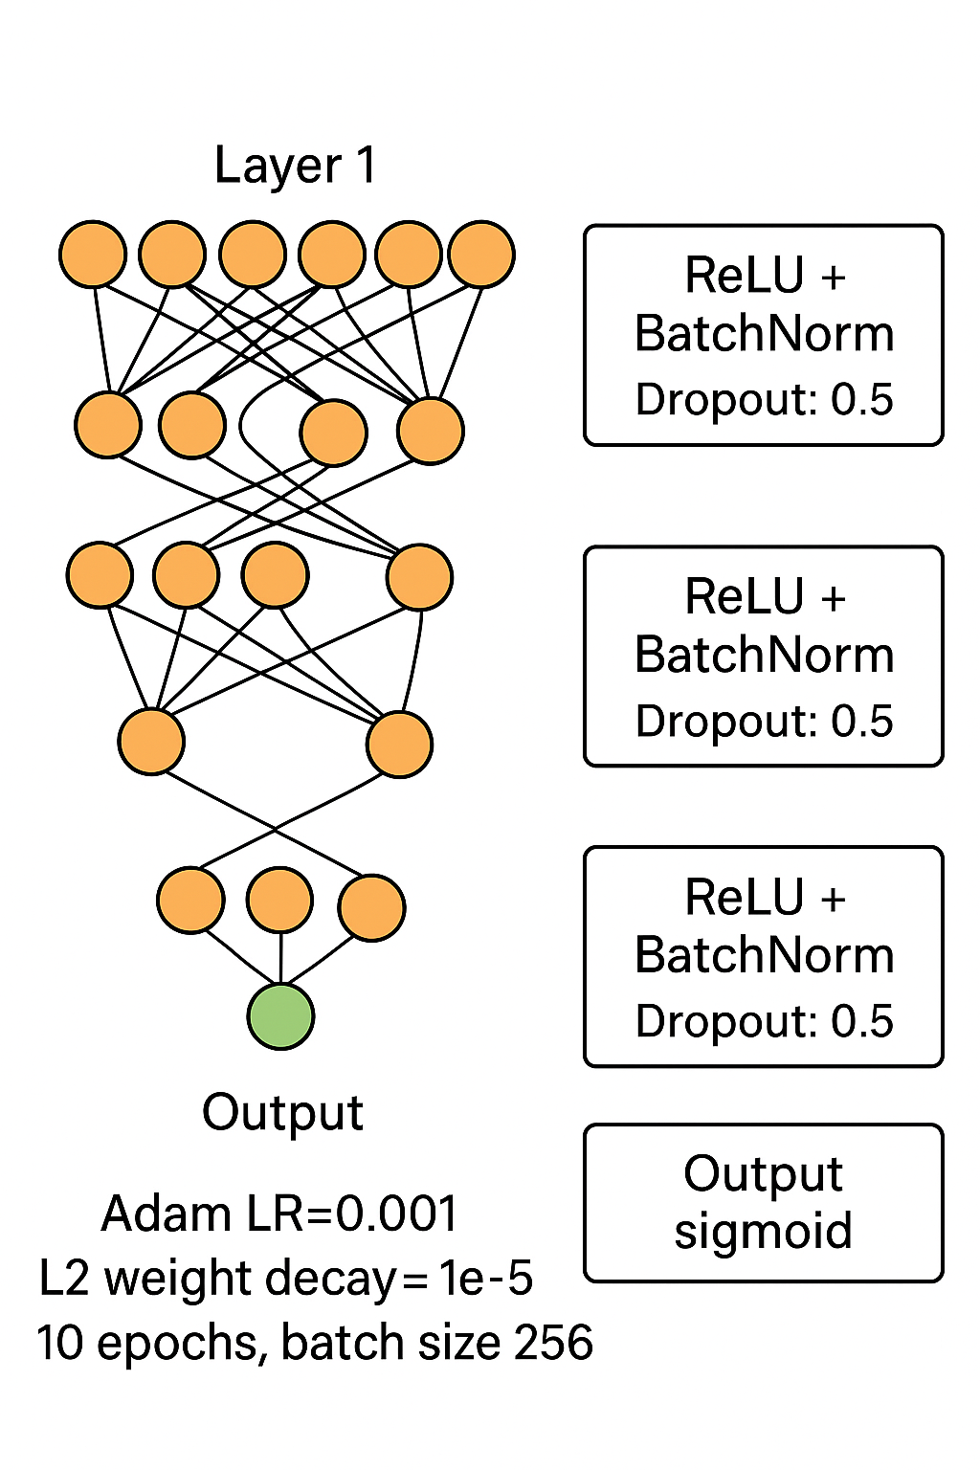
Architettura del modello
Rete fully-connected: • Layer 1: 4000 neuroni • Layer 2: 2000 neuroni • Layer 3: 100 neuroni • Output sigmoid ReLU + BatchNorm su ogni layer. Dropout: 0.5 Adam LR=0.001 L2 weight decay = 1e−5 10 epoche, batch size 256.

Slide 22
Attacco implementato
1
Clean-label backdoor su 1% e 3% dei benigni con 16/32/64/128 feature modificate
2
Trigger = pattern basato su valori di feature malevoli

Slide 23
Ipotesi sperimentale
I campioni avvelenati dovrebbero:
rimanere stabili alla perturbazione
continuare ad essere classificati come benigni quindi apparire come outlier resilienti al rumore

Slide 24

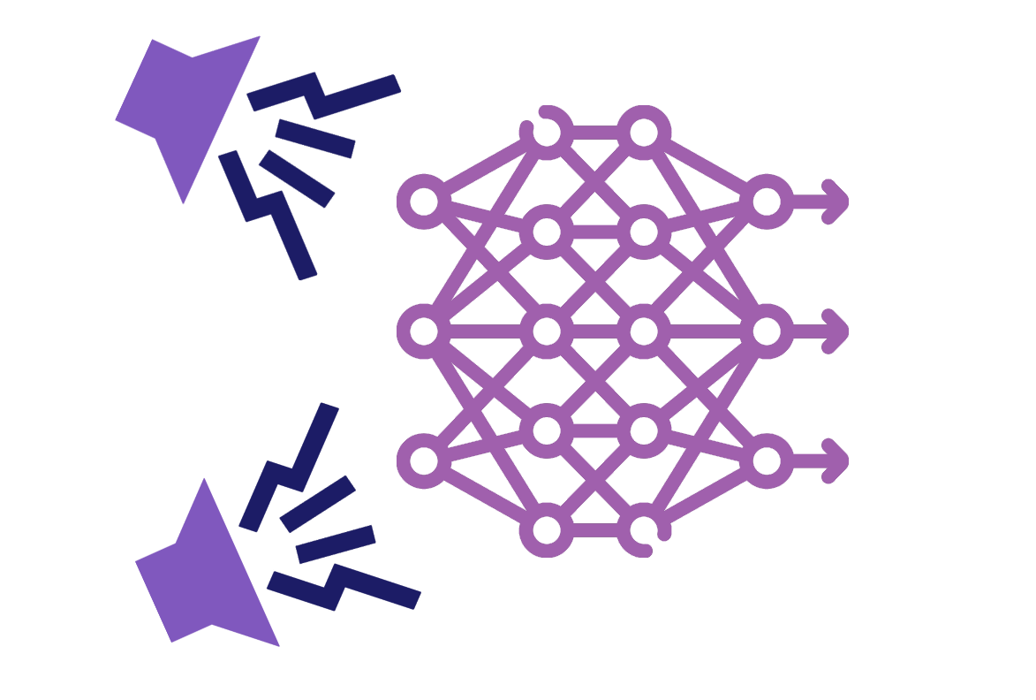
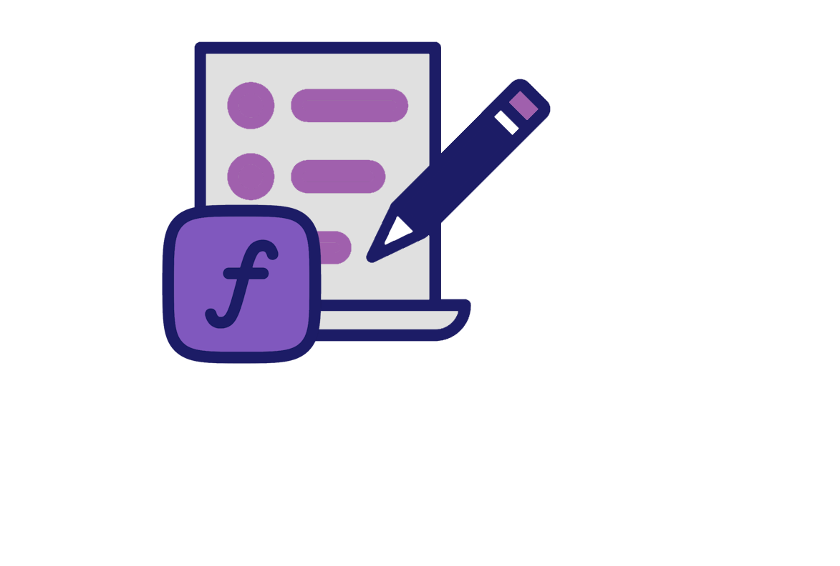
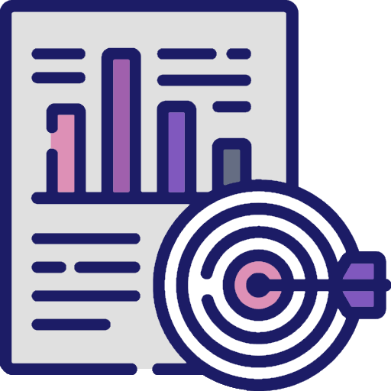
Rumore gaussiano e criteri di scelta
01
02
03
04
σ testati: 0.0001 e 0.01
Rumore aggiunto solo ai pesi, non ai bias
Funzione di selezione automatica del rumore “ottimale”
accuracy ≥ 50% e massima differenza tra predizione del modello avvelenato e disturbato

Slide 25
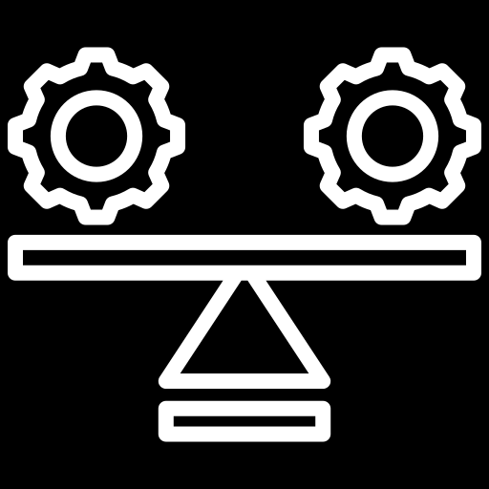
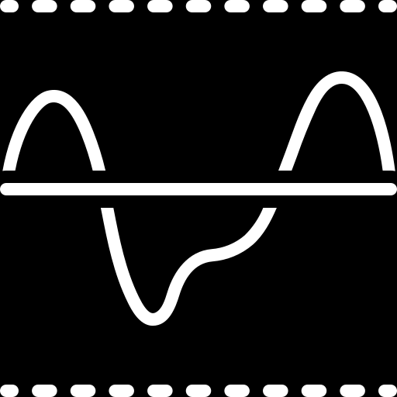
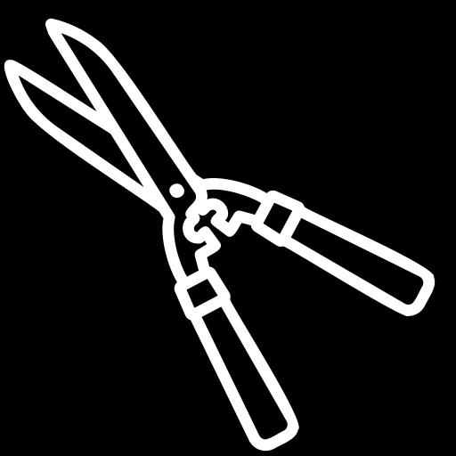
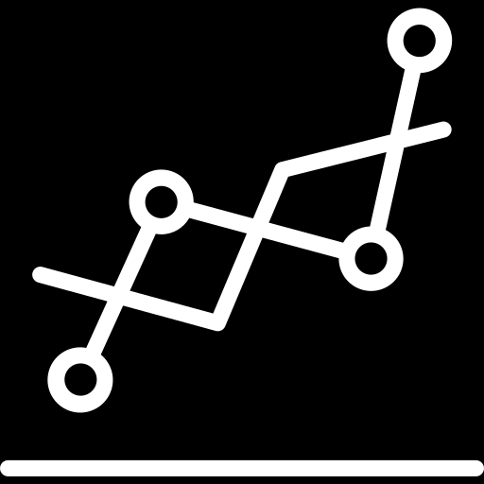
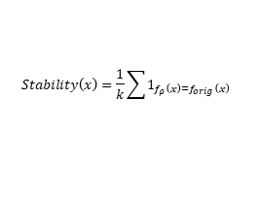
Sparsificazione
Stability score
Threshold variabile
$$Stability\left(x\right)=\frac{1}{k}\sum{1_{f_{ρ}\left(x\right)=f_{orig}\left(x\right)}}$$
Soglia = 10° percentile della distribuzione.
Sotto questa soglia c’è un sospetto avvelenato
Pruning
Confronto
Pruning su percentuali 0–90%. Pesi sotto il quantile ρ vengono azzerati
Si analizza la stabilità della predizione con vari pruning rate

Slide 26
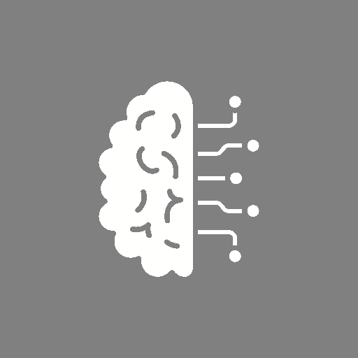


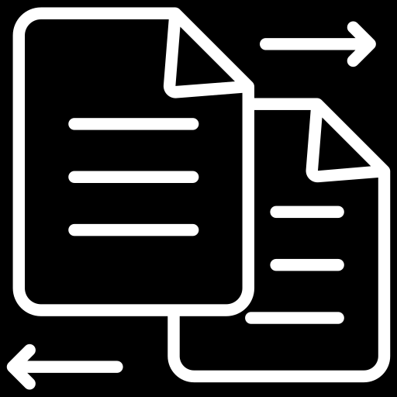
Pipeline dei test
Addestramento modello su dataset avvelenato
Calcolo stability score e confronto con Isolation Forest
TRAIN
DEFEND
POISON
COMPARE
Addestramento modello “clean”
Iniezione rumore sui pesi e pruning progressivo 0–90%

Slide 27
Risultati attesi
Il poisoning degrada le performance
Campioni avvelenati più stabili dei puliti
Possibili differenze di stabilità
Confronto con benchmark: Isolation Forest ~99% recovery
DEGRADO
STABILITÁ
PRUNING
BENCHMARK

Slide 28
Limiti sui dati
Usato solo EMBER 2018
Contagio non replicabile per mancanza di subset chiari
Drebin non accessibile
Dataset molto grande → necessità di riduzione

Slide 29
Limiti computazionali
Feature analysis solo su 10% dei dati
Macchine limitate → batch size ridotta
Feature analysis solo su 10% dei dati
SHAP computazionalmente pesante → campionamento ridotto

Slide 30
Limiti dei test
Pruning non ottimizzato iterativamente
Difficoltà a replicare fedelmente tutte le metriche del paper
Rumore calibrato ma non esplorato su larga scala
Attacchi testati solo con 1%–3% poisoning

Slide 31
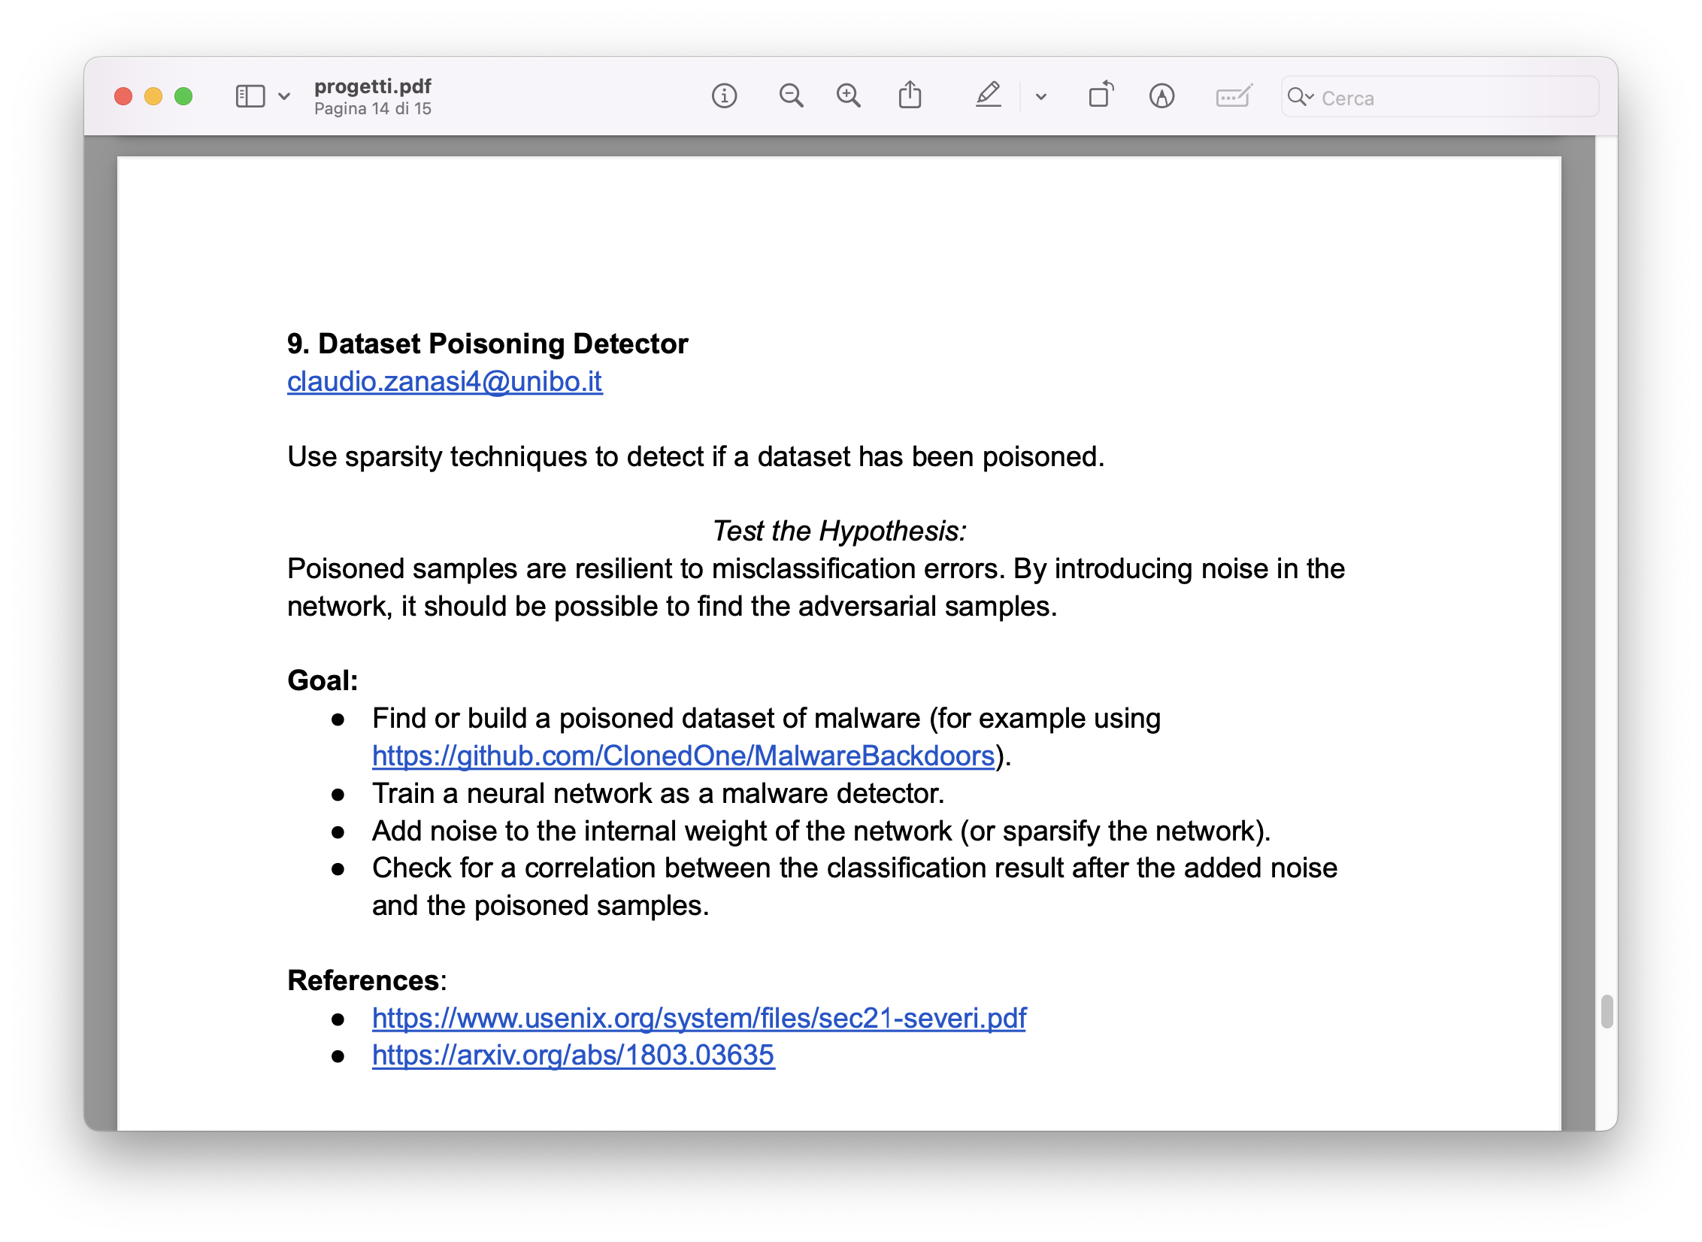
Thesis

Slide 32
THE LOTTERY TICKET HYPOTHESIS: FINDING SPARSE, TRAINABLE NEURAL NETWORKS
Proprierty

Slide 33
Cybersecurity Infographics
MERCURY
VENUS
MARS
It’s a very small planet
Venus has a beautiful name
Mars is a cold place
JUPITER
NEPTUNE
SATURN
Jupiter is the biggest planet
It’s the farthest planet
Yes, Saturn is the ringed one

Slide 34
Cybersecurity Infographics
MERCURY
VENUS
MARS
It’s a very small planet
Venus has a beautiful name
Mars is a cold place
JUPITER
NEPTUNE
SATURN
Jupiter is the biggest planet
It’s the farthest planet
Yes, Saturn is the ringed one

Slide 35
Cybersecurity Infographics
MERCURY
MARS
Mercury is the smallest planet
Mars is actually a cold place
VENUS
NEPTUNE
Venus has a beautiful name
It’s the farthest planet
JUPITER
SATURN
Jupiter is the biggest planet
Yes, Saturn is the ringed one

Slide 36
Cybersecurity Infographics
MERCURY
MARS
Mercury is the smallest planet
Mars is actually a cold place
JUPITER
SATURN
Jupiter is the biggest planet
Yes, Saturn is the ringed one

Slide 37
Cybersecurity Infographics
MERCURY | Mercury is the closest planet to the Sun
NEPTUNE | Neptune is the farthest planet from the Sun
MARS | Despite being red, Mars is actually a cold place
VENUS | Venus has a beautiful name, but it’s very hot

Slide 38
Cybersecurity Infographics
MERCURY
MARS
Mercury is the smallest planet
Mars is actually a cold place
JUPITER
SATURN
Jupiter is the biggest planet
Yes, Saturn is the ringed one

Slide 39
Cybersecurity Infographics
MERCURY
Mercury is the smallest and innermost planet
It’s the farthest
planet from the Sun
NEPTUNE
MARS
Despite being red, Mars is a very cold place
Venus is the second planet from the Sun
VENUS

Slide 40
Cybersecurity Infographics
01
02
03
04
MERCURY
MARS
JUPITER
VENUS
It's the closest planet to the Sun
Despite being red, Mars is a cold place
It's a gas giant and the biggest planet
Venus is the second planet to the Sun

Slide 41
Cybersecurity Infographics
MERCURY
MARS
JUPITER
VENUS
SATURN
It's the closest planet to the Sun
Despite being red, Mars is a cold place
It's a gas giant and the biggest planet
Venus is the second planet to the Sun
Yes, Saturn is the ringed one

Slide 42
Cybersecurity Infographics
MERCURY
VENUS
MARS
It’s a very small planet
Venus has a beautiful name
Mars is a cold place
JUPITER
NEPTUNE
SATURN
Jupiter is the biggest planet
It’s the farthest planet
Yes, Saturn is the ringed one

Slide 43
Cybersecurity Infographics
MERCURY
MARS
Mercury is the smallest planet
Mars is actually a cold place
VENUS
NEPTUNE
Venus has a beautiful name
It’s the farthest planet
JUPITER
SATURN
Jupiter is the biggest planet
Yes, Saturn is the ringed one

Slide 44
Cybersecurity Infographics
MERCURY
MARS
Mercury is the smallest planet
Mars is actually a cold place
VENUS
NEPTUNE
Venus has a beautiful name
It’s the farthest planet
JUPITER
SATURN
Jupiter is the biggest planet
Yes, Saturn is the ringed one

Slide 45
Cybersecurity Infographics
MERCURY
MARS
JUPITER
VENUS
It's the closest planet to the Sun
Despite being red, Mars is a cold place
It's a gas giant and the biggest planet
Venus is the second planet to the Sun

Slide 46
Cybersecurity Infographics
MERCURY
Mercury is the smallest planet
VENUS
NEPTUNE
Venus has a beautiful name
It’s the farthest planet
JUPITER
SATURN
Jupiter is the biggest planet
Yes, Saturn is the ringed one

Slide 47
Cybersecurity Infographics
MERCURY
MARS
JUPITER
VENUS
It's the closest planet to the Sun
Despite being red, Mars is a cold place
It's a gas giant and the biggest planet
Venus is the second planet to the Sun

Slide 48
Cybersecurity Infographics
MERCURY
MARS
Mercury is the smallest planet
Mars is actually a cold place
VENUS
NEPTUNE
Venus has a beautiful name
It’s the farthest planet
JUPITER
SATURN
Jupiter is the biggest planet
Yes, Saturn is the ringed one

Slide 49
Cybersecurity Infographics
MERCURY
MARS
Mercury is the smallest planet
Mars is actually a cold place
VENUS
NEPTUNE
Venus has a beautiful name
It’s the farthest planet
JUPITER
SATURN
Jupiter is the biggest planet
Yes, Saturn is the ringed one

Slide 50
Cybersecurity Infographics
Mercury is the smallest planet of them all
Neptune is the farthest planet from the Sun
JUPITER
VENUS
MERCURY
NEPTUNE
Jupiter is the fifth planet from the Sun and the largest
Venus is the second planet from the Sun. It has a beautiful name

Slide 51
Cybersecurity Infographics
MERCURY
MARS
Mercury is the smallest planet
Mars is actually a cold place
VENUS
NEPTUNE
Venus has a beautiful name
It’s the farthest planet
JUPITER
SATURN
Jupiter is the biggest planet
Yes, Saturn is the ringed one

Slide 52
Cybersecurity Infographics
JUPITER
Jupiter is the fifth planet from the Sun
NEPTUNE
Neptune is the farthest planet from the Sun
SATURN
Mercury is the smallest planet of them all

Slide 53
Cybersecurity Infographics
EARTH
MERCURY
VENUS
MARS
Mercury is the closest planet
Venus has a beautiful name
Mars is a cold place
JUPITER
NEPTUNE
SATURN
Jupiter is the biggest planet
It’s the farthest planet
Yes, Saturn is the ringed one

Slide 54
Cybersecurity Infographics
Mercury is the closest planet to the Sun and the smallest one in the Solar System
1
Jupiter is a gas giant and actually also the biggest planet in the Solar System
2
Saturn is a gas giant in the Solar System, composed mostly of hydrogen and helium
3
Venus has a beautiful name and is the second planet from the Sun

Slide 55
Cybersecurity Infographics
EARTH
NEPTUNE
MARS
MERCURY
Earth is the third planet from the Sun
It’s the farthest planet from the Sun
Despite being red, Mars is a cold place
Mercury is the closest object to the Sun

Slide 56
Cybersecurity Infographics
Venus is the second planet from the Sun
Venus is the second planet from the Sun
Neptune is the farthest known planet

Slide 57
Cybersecurity Infographics
MERCURY
VENUS
Mercury is the closest planet
Venus has a beautiful name
JUPITER
NEPTUNE
Jupiter is the biggest planet
It’s the farthest planet

Slide 58
Cybersecurity Infographics
NEPTUNE
MARS
JUPITER
Neptune is the farthest planet from the Sun
Despite being red, Mars is a cold place
Jupiter is a gas giant and the biggest planet
EARTH
SATURN
MERCURY
Earth is the third planet from the Sun
It’s composed of hydrogen and helium
Mercury is the closest object to the Sun

Slide 59
Cybersecurity Infographics
Despite being red, Mars is a cold place
It’s the farthest planet from the Sun
Jupiter the biggest planet of them all
Mercury closest planet to the Sun
MARS
NEPTUNE
JUPITER
MERCURY

Slide 60
Cybersecurity Infographics
EARTH
NEPTUNE
MARS
MERCURY
Earth is the third planet from the Sun
It’s the farthest planet from the Sun
Despite being red, Mars is a cold place
Mercury is the closest object to the Sun

Slide 61
Cybersecurity Infographics
MERCURY
MARS
Mercury is the smallest planet
Mars is actually a cold place
VENUS
NEPTUNE
Venus has a beautiful name
It’s the farthest planet
EARTH
JUPITER
SATURN
Jupiter is the biggest planet
Is the third planet from the Sun
Yes, Saturn is the ringed one

Slide 62
Instructions for use (free users)
In order to use this template, you must credit Slidesgo by keeping the Thanks slide.
You are allowed to:
Modify this template.
Use it for both personal and commercial purposes.
You are not allowed to:
Sublicense, sell or rent any of Slidesgo Content (or a modified version of Slidesgo Content).
Distribute this Slidesgo Template (or a modified version of this Slidesgo Template) or include it in a database or in any other product or service that offers downloadable images, icons or presentations that may be subject to distribution or resale.
Use any of the elements that are part of this Slidesgo Template in an isolated and separated way from this Template.
Delete the “Thanks” or “Credits” slide.
Register any of the elements that are part of this template as a trademark or logo, or register it as a work in an intellectual property registry or similar.
For more information about editing slides, please read our FAQs or visit Slidesgo School:
https://slidesgo.com/faqs and https://slidesgo.com/slidesgo-school

Slide 63
Instructions for use (premium users)
In order to use this template, you must be a Premium user on Slidesgo.
You are allowed to:
Modify this template.
Use it for both personal and commercial purposes.
Hide or delete the “Thanks” slide and the mention to Slidesgo in the credits.
Share this template in an editable format with people who are not part of your team.
You are not allowed to:
Sublicense, sell or rent this Slidesgo Template (or a modified version of this Slidesgo Template).
Distribute this Slidesgo Template (or a modified version of this Slidesgo Template) or include it in a database or in any other product or service that offers downloadable images, icons or presentations that may be subject to distribution or resale.
Use any of the elements that are part of this Slidesgo Template in an isolated and separated way from this Template.
Register any of the elements that are part of this template as a trademark or logo, or register it as a work in an intellectual property registry or similar.
For more information about editing slides, please read our FAQs or visit Slidesgo School:
https://slidesgo.com/faqs and https://slidesgo.com/slidesgo-school

Slide 64
Infographics
You can add and edit some infographics to your presentation to show your data in a visual way.
Choose your favourite infographic and insert it in your presentation using Ctrl C + Ctrl V or Cmd C + Cmd V in Mac.
Select one of the parts and ungroup it by right-clicking and choosing “Ungroup”.
Change the color by clicking on the paint bucket.
Then resize the element by clicking and dragging one of the square-shaped points of its bounding box (the cursor should look like a double-headed arrow). Remember to hold Shift while dragging to keep the proportions.
Group the elements again by selecting them, right-clicking and choosing “Group”.
Repeat the steps above with the other parts and when you’re done editing, copy the end result and paste it into your presentation.
Remember to choose the “Keep source formatting” option so that it keeps the design. For more info, please visit Slidesgo School.

